Slide 1
Introduction to Java for Business BU350.700.51 Spring I 2025
Java Control Flow Constructs

Slide 2
Java Control Flow Constructs
Iteration Constructs
for
while
do-while
Conditional Constructs
if
if-else
Switch
Jump Statements
break statement
continue statement
Except for using break with a switch try to avoid these

Slide 3
The for Construct
for ( expr1; expr2; expr3 )
{
… statements …
}

Slide 4
for Construct Example
// Program to illustrate the for construct
//
// Program Output: i = 1 j = 2
// i = 2 j = 4
// i = 3 j = 6
// i = 4 j = 8
// i = 5 j = 10
public class forDemo
{
public static void main( String [] args )
{
int i;
int j;
for( i = 1; i <= 5; i++ )
{
j = 2 * i;
System.out.println( " i = " + i + " j = " + j );
}
}
}

Slide 5
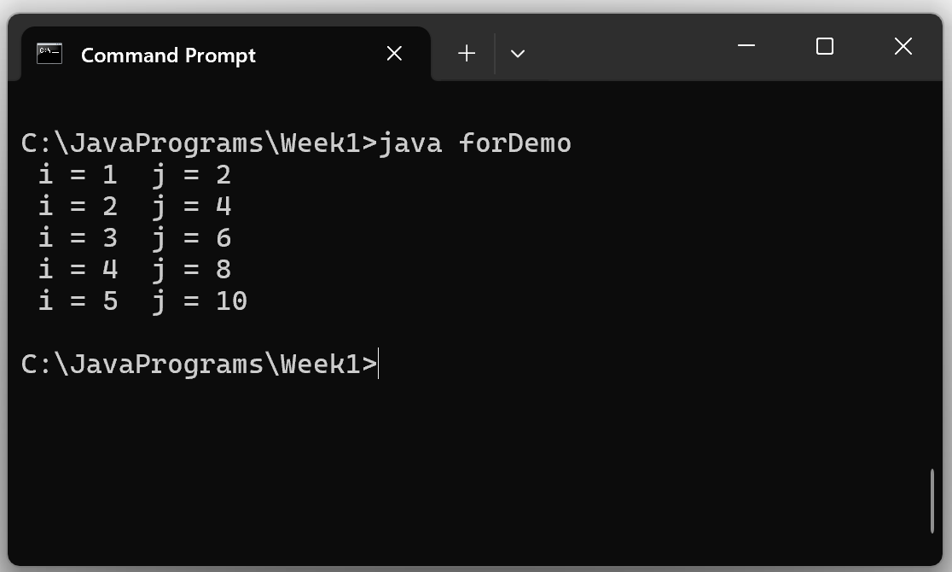
for Construct Example

Slide 6
The while Construct
while ( expr )
{
… statements …
}

Slide 7
while Construct Example
// Program to illustrate the while construct
//
// Program Output: Beginning while loop!
// x is 5
// x is 4
// x is 3
// x is 1
// All Done!
public class whileDemo
{
public static void main( String [] args )
{
int x = 5;
System.out.println( "Beginning while loop!" );
while ( x > 0 ) // relational expression tested
{
System.out.println( "x is " + x );
x = x - 1;
}
System.out.println( "All Done!" );
}
}

Slide 8
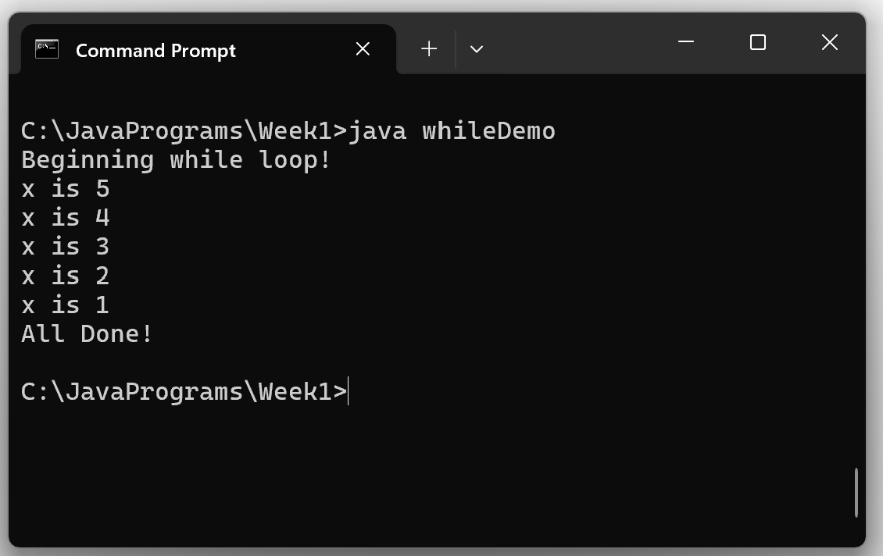
while Construct Example

Slide 9
The do-while Construct
do
{
… statements …
} while ( expr );

Slide 10
do-while Construct Example
// Program to illustrate the do-while construct
//
// Program Output: Beginning do-while loop!
// x is 5
// x is 4
// x is 3
// x is 1
// All Done!
public class doWhileDemo
{
public static void main( String [] args )
{
int x = 5;
System.out.println( "Beginning do-while loop!" );
do
{
System.out.println( "x is " + x );
x = x - 1;
} while ( x > 0 ); // relational expression tested
System.out.println( "All Done!" );
}
}

Slide 11
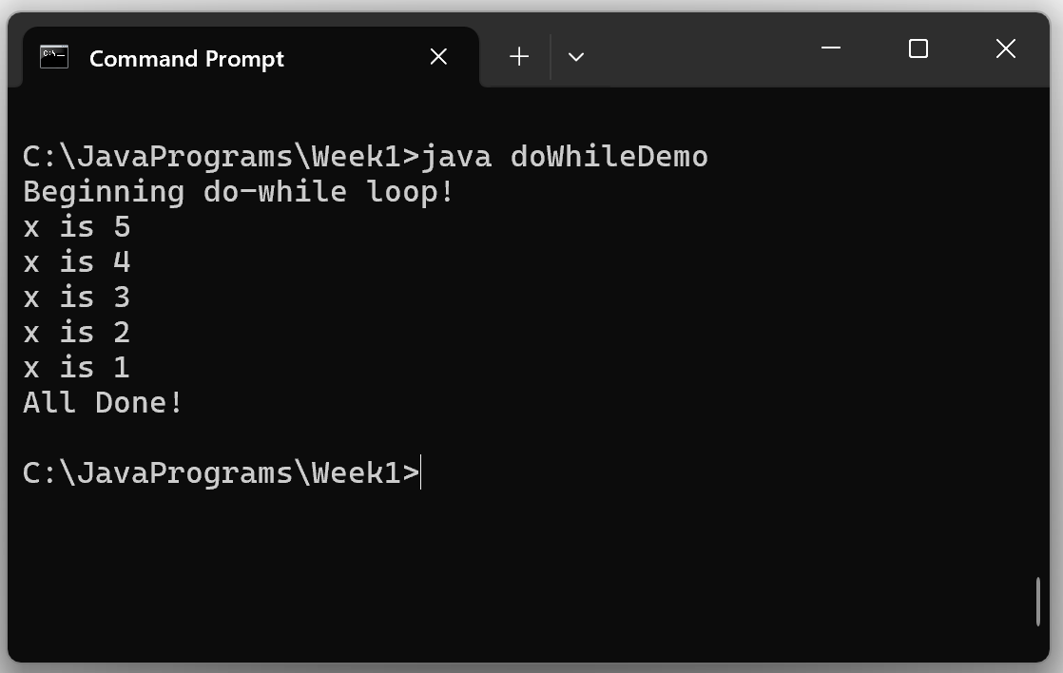
do-while Construct Example

Slide 12
The if-else Construct
if ( expr )
{
… stmts1 …
}
else
{
… stmts2 …
}

Slide 13
if-else Construct Example

Slide 14
if-else Example

Slide 15
The “else” is Not Always Required

Slide 16
The switch Construct
NOTE: Keywords are shown in boldface

Slide 17
Notes on the switch Construct
The control expression ( expr ) must evaluate to a byte, short, int, char, String or an enumeration
Case labels must be hard-coded or final variables
All case labels must be unique
Once control is transferred to a case label, all statements are executed until a break is encountered

Slide 18
switch Construct Example
// Program to illustrate the switch construct
//
// Program Output: Today is Friday
public class switchDemo
{
public static void main( String [] args )
{
int dayOfWeek = 5;
switch( dayOfWeek )
{
case 1: System.out.println( "Today is Monday" );
break;
case 2: System.out.println( "Today is Tuesday" );
break;
case 3: System.out.println( "Today is Wednesday" );
break;
case 4: System.out.println( "Today is Thursday" );
break;
case 5: System.out.println( "Today is Friday" );
break;
case 6: System.out.println( "Today is Saturday" );
break;
case 7: System.out.println( "Today is Sunday" );
break;
default:
System.out.println( "Invalid day of week" );
}
}
}

